Slide 1

Healthcare analytics
An INTRO
PRESENTED BY,
Mohamed Azarudeen AS

Slide 2
INTRO
What is HealthCare Analytics?
Health care analytics is a subset of data analytics that uses both historical and current data to produce actionable insights, improve decision-making, and optimize outcomes within the health care industry
Health care analytics is not only used to benefit health care organizations but also to improve the patient experience and health outcomes

Slide 3
Data analytics in health care
The health care industry is awash with valuable data in the form of detailed records. Industry regulations stipulate that health care providers must retain many records for a set period
This means that health care has become a site of interest for those working with "big data", or large pools of unstructured data
As a still-developing field, big data analytics in health care offers the potential to reduce operation costs, improve efficiency, and treat patients

Slide 4
Predictive analytics in health care
Predictive analytics uses historical data to identify past trends and project-associated future outcomes
In the health care industry, predictive analytics has many impactful uses, such as identifying a patient’s risk for developing a health condition and streamlining treatment courses

Slide 5
Prescriptive analytics in health care
Prescriptive analytics uses historical data to identify an appropriate course of action
In the health care industry, prescriptive analytics is used to direct business decisions and literally prescribe treatment plans for patients
As a result, some of the most common uses of prescriptive analytics in health care include identifying a patient’s likelihood of developing diabetes, allocating ventilators for a hospital unit, and enhancing diagnostic imaging tools

Slide 6
Benefits of data analytics in health care
Health care analytics benefits health businesses, hospital administrators, and patients
At a glance, some of the most common benefits of health care analytics include:
Improved patient care, such as offering more effective courses of treatment
Predictions for a patient’s vulnerability to a particular medical condition
Improved scheduling for both patients and staff
More efficient decision-making at the business and patient care level

Slide 7
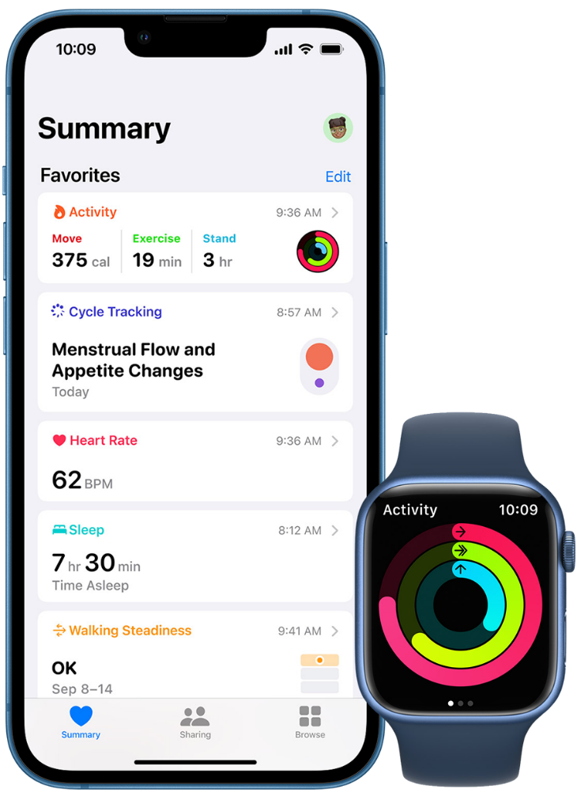

Social media analytics

Slide 8
Social media analytics
Social media analytics has proved to be a revolutionary tool for the healthcare industry as it has perfectly bridged the gap between patients and healthcare
The healthcare organizations are able to showcase their positive aspects to their targeted audience as they have better understanding about their market now
We want to know about health these days is just a click away. In fact, search engines are the first thing people resort to when they face any health issue
Ex: Google fit, Apple Health

Slide 9
DATASETS
A data set (or dataset) is a collection of data. In the case of tabular data, a data set corresponds to one or more database tables, where every column of a table represents a particular variable and each row corresponds to a given record of the data set

Slide 10
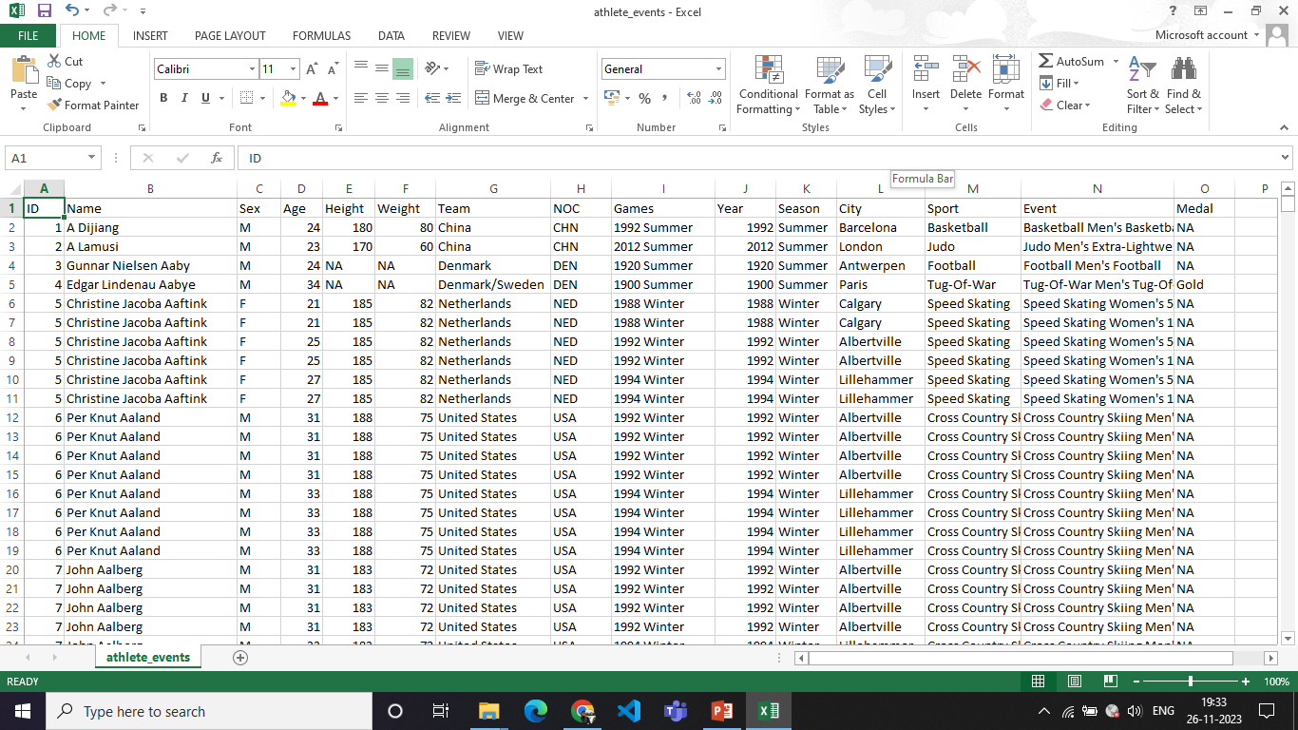
DATASET

Slide 11
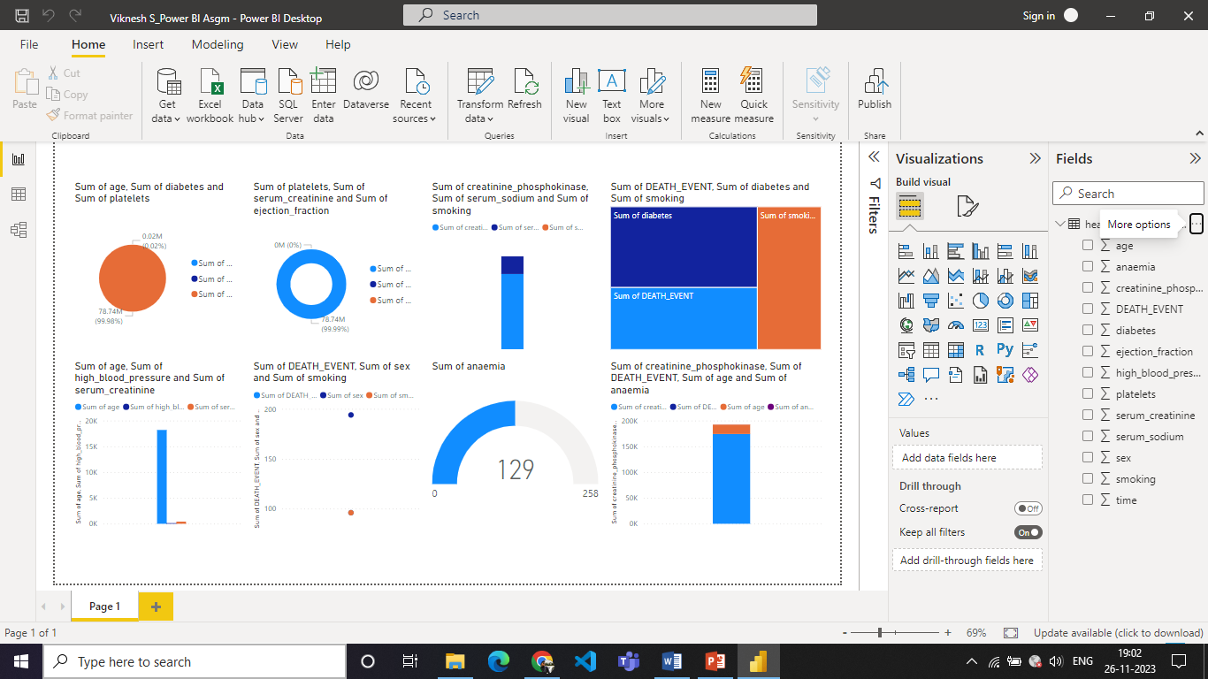
DATA VISUALIZATION
For Ex: Heart failure prediction

Slide 12
THANK YOU!!

